Slide 1
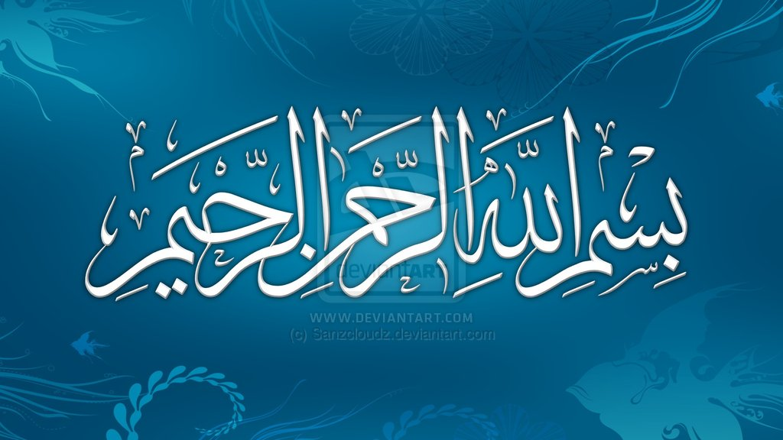

Slide 2
NURUL QURAN SABEEL-UL-JANNAH 2017
NAME:
SHAHINA ASHRAF
TOPIC;
HAJJ

Slide 3
TOPIC: HAJJ
What is hajj
Meaning and importance of hajj
Kinds of hajj
Conditions for hajj
Forbidden deeds during hajj
Benefits of hajj
1st day 8th Dhul hajj
2nd day 9th Dhul hajj
3rd day 10th Dhul hajj
11th,12th and 13th iyyam-e-tashreeq
Pupose of hajj
Self assessment points

Slide 4
What is hajj
Hajj is the fifth pillar of Islam
Like other pillars of Islam, it molds our life and prepare us so that we may live in our lives by surrendering to ALLAH (SWT)

Slide 5
Meaning and importance of hajj
The term hajj derived from arabic word “hajj” means heading for an honorable person or place.
ALLAH (SWT) said in surah Al-imran
“and hajj to the house is duty on mankind, those who can afford the expenses and whoever disbelieves, then ALLAH is all sufficient, needing nothing from all worlds.
“That , and he who glorifies ALLAH’S rituals, it is (a sign of) piety of heart.”(surah al-hajj)
Hadith of Prophet Muhammad (SAW)
“Whoever performs hajj without any obscenity shall return (from hajj) like a new born baby”

Slide 6
Kinds of hajj
Ifrad
Hajj only without umrah.
No hadi (animal sacrifice) is required.
Qiraan
Hajj and umrah with single ihram.
Hadi is required.
AL-Tamattu
Hajj and umrah seprated with two different ihram.
Hadi is required.

Slide 7
Conditions for hajj
Muslim
Free
Sound state of mind
Adult
Possession of wealth extra wealth that is sufficient for transportation, provisions and maintenance of one’s family till return.
Women requires a Mahram

Slide 8
Forbidden deeds during ihram
Fusuq (sins)
Jidal (arguments)
Sextual activity
He/She should not wear shirt, nor pants, nor cap, wearing gloves and covering face.
No shoes that cover the entire feet nd no socks.

Slide 9
Benefits of hajj
Completing the fifth pillar of islam.
Leaving wealth and family for the pleasure of ALLAH.
Patience under all circumstances.
Spending wealth earned from halal means.
Praising ALLAH a lot.
It is a show of submission nd servitude.
Cooperation for goodness against evil.
Knowing all muslims from all over the world.
Sharing with others (resources, knowledge etc).
Total forgivness for all past sins.

Slide 10
First day of hajj (8th Dhul hajj)
Put on ihram
Declare intention
Recite Talbiyah
Overnight stay in mina
First day of hajj completed
Offer five prayers in Mina
Go to Mina before zuhar

Slide 11
2nd Day of Hajj (9th Dhul Hajj)
You are in Mina Go to Arafa after sunrise
Pray zuhar and Asar at the time of Zuhar
Stay in Arafa till after sunset
After sunset go to Muzzdalifa
Pray Maghrin and Isha in Muzzdalifa
Pick up 7 or 49 pebbels
Stay overnight in Muzzdalifa

Slide 12
3rd Day of hajj (10th of Dhul hajj)
You are in Muzdalifa
After Fajr go to in Mina
Go to Jamrat-ul-AQABA
Haircut shave/clip
Remove ihram put on usual dress
Go to Masjid-e-Haram
Make Tawaf
(seven circutts)
Pray 2 Rakkah near Muqam-e-Ibrahim
Drink zamzam water
Sacrifice animal
Sa’iy
Seven runs between Safa and Marwa
Go back to Mina Stay overnight in Mina

Slide 13
11th ,12th and 13th Dhul Hajj (iyyam-e-Tashreeq)
You are in Mina
After zuhar go to all three jamrat
First jamrat
(jamrat-ul-oola)
2nd jamrat
(jamrat-ul-wusta)
3rd jamrat
Jamrat-ul-Aqabaa
After 12th or 13th before sunset go to Makkah
Before leaving Makkah perform Tawaf-ul -Wadda
Now hajj is completed
Go to Madina and visit historical places

Slide 14
Purpose of hajj
The pilgrim also enables muslims all around the world of different colors, language and races to come together in a strong brotherhood and sisterhood to worship the One ALLAH together.
The hajj is designed to develop TAQWA
To bring up our imaan

Slide 15
Self Assessment point
After performing hajj you will be totally changed.
Your heart filled with fear of ALLAH (SwT).
Remember ALLAH a lot that HE gives you hidayah and forgive your past sins.
When try to commit sin ALLAH’S fear stops you from committing sins.
Hajj is training session that how we should live either we have different nature and help others.
jazzakALLAH hu khair all for your attention, we pray we all are able to perform hajj soon.
We pray we are able to be like Prophet IBRAHIM (AS) and recite Darood-e-Ibrahimi.

